Slide 1
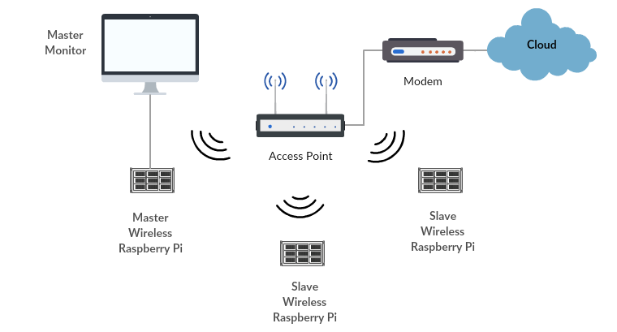

S.N.I.F.F.E.R.O.N.I. Silent Network Inspection For False and Erroneous Routing On Network Infrastructure
Students:
Cody Ebert
Christopher Henderson
Dylan Secreast
Motivation
October 2016 DDoS against Dyn used a myriad of IoT devices
Detecting DDoS attacks on IoT networks can help prevent attacks such as the one against Dyn
Sample Design
Equipment
Raspberry Pi 3 Model B v1.2
Alfa AWUS036NEH WiFi dongle
Netgear N600 WiFi router
Problems
IoT networks are extremely vulnerable and traditional detection methods implementation is not inexpensive.
Project Issues
Lack of standardization of monitor mode capable WiFi chipsets
ARM architecture is very resource limited
Objectives
Identify type and frequency of packet protocols to detect potential DDoS attacks
Use an inexpensive hardware to monitor data

